Slide 1

Packet Sniffer Project
Bachelor of Technology
in
Computer Science and Engineering
Supervised By:
Dr. Rakesh Kumar Galav
Prepared By:
Ayush Kumar Saxena
Tripti Yadav
Naman Agrawal
Kuldeep Tiwari

Slide 2
OBJECTIVE-
Our objective is to construct a Packet sniffer such
that it will read packet that travel across the network
layer of the Transmission Control Protocol/Internet
Protocol (TCP/IP) layer responses and packet
sniffer does is to gather, collect, and log the packets
that pass through a computer network and it will save
the response in a text file.
Notes:
2

Slide 3
Packet Sniffers
Host A
Host B
Router A
Router B
Sniffers are programs that can capture/sniff/detect network traffic packet by packet and analyse them for various reasons. Commonly used in the field of network security.
Wireshark is a very common packet sniffer/protocol analyzer. Packet sniffers can be written in python too.
Notes:
3

Slide 4
Sniffing Method
Sniffing method works in switched and non-switched network .
Sniffing Methods-
IP –Based sniffing
MAC-Based Sniffing
ARP-Based Sniffing

Slide 5
What can be sniffed? One can sniff the following sensitive information from a network −
Email traffic
FTP passwords
Web traffics
Telnet passwords
Router configuration
Chat sessions
DNS traffic

Slide 6
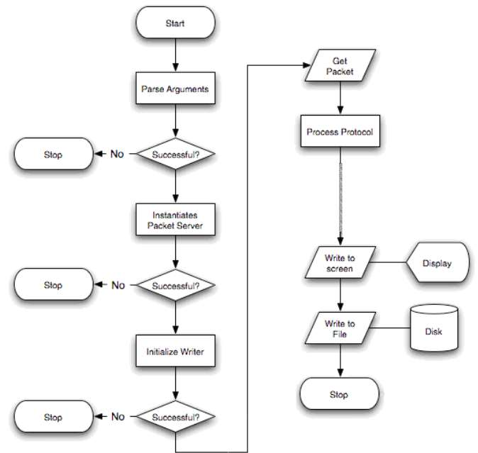
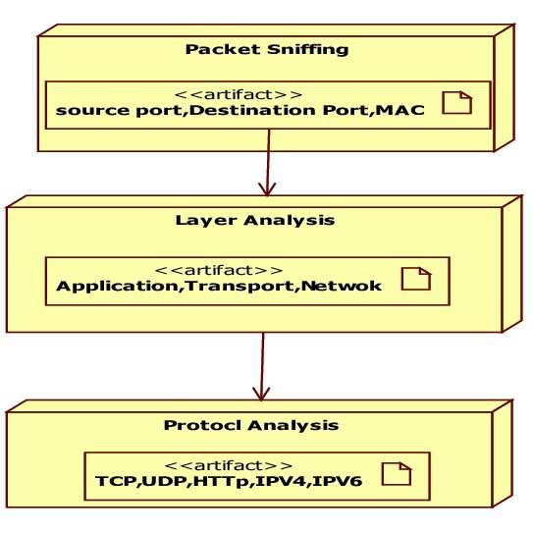
Process Flow Diagram-

Slide 7

Tools and Technologies-
Scrapy Library-
Scrapy is a Python framework for large scale web scraping. It gives you all the tools you need to efficiently extract data from websites, process them as you want, and store them in your preferred structure and format. It is an open source and collaborative framework for extracting the data you need from websites.
In a fast, simple, yet extensible way.

Slide 8
This tool will be useful as
To capture packets over a network connection, It can be used for major functions like packet capturing, fake packet generation, and filtering.
Allow you to scan any given website and produce a list of links found in the site, using several criteria to filter the results.
Monitor all the TCP/IP connections from your computer to the internet automatically
Capture username and passwords

Slide 9
Thanks for your time!

